Slide 1
Building Node.js Applications on Windows Azure
Aidan Casey

Slide 2



Introduce myself
Solutions Architect at MYOB
Born in Dublin Ireland, moved to Australia in 2006
16 years development experience working with Microsoft technologies
Currently working a cloud platform for the next generation of MYOB’s accounting products – (C#.NET ,WCF, SQL Server, .NET 4.0)
aidancasey@gmail.com
http://www.linkedin.com/pub/aidan-casey/2/a71/353
git@github.com:aidancasey/AzureNodeChatClient.git

Slide 3
Agenda
Introduction to node.js
Explain event-driven, non-blocking I/O processing
NPM (node package manager)
Build and publish a simple chat room application to azure
Tooling – editors , debuggers, unit testing

Slide 4

What is node.js
Open source project started in 2009
Server side technology for building scalable network programs.
Executes server side JavaScript code using Google's V8 JavaScript engine
Asynchronous architecture - pure evented I/O with non blocking infrastructure , everything executes on a single thread
Very popular amongst the developer community, large ecosystem of open source modules has emerged
Many hosting options – Azure, AppHarbour, Heroku, NodeSter.com(EC2,Rackspace,GoGrid!)

Slide 5
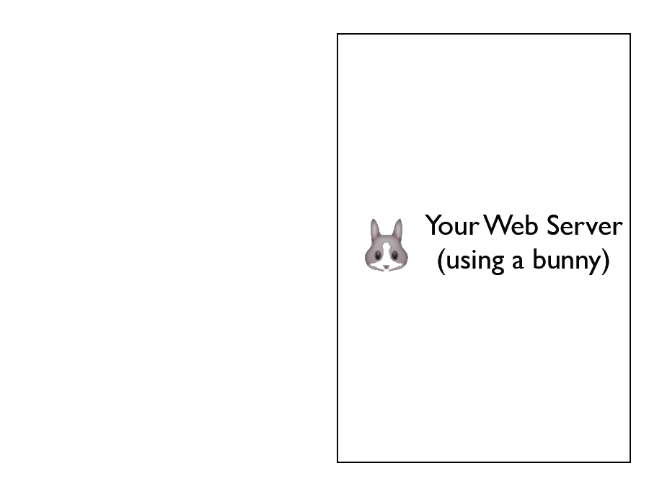

Slide 6
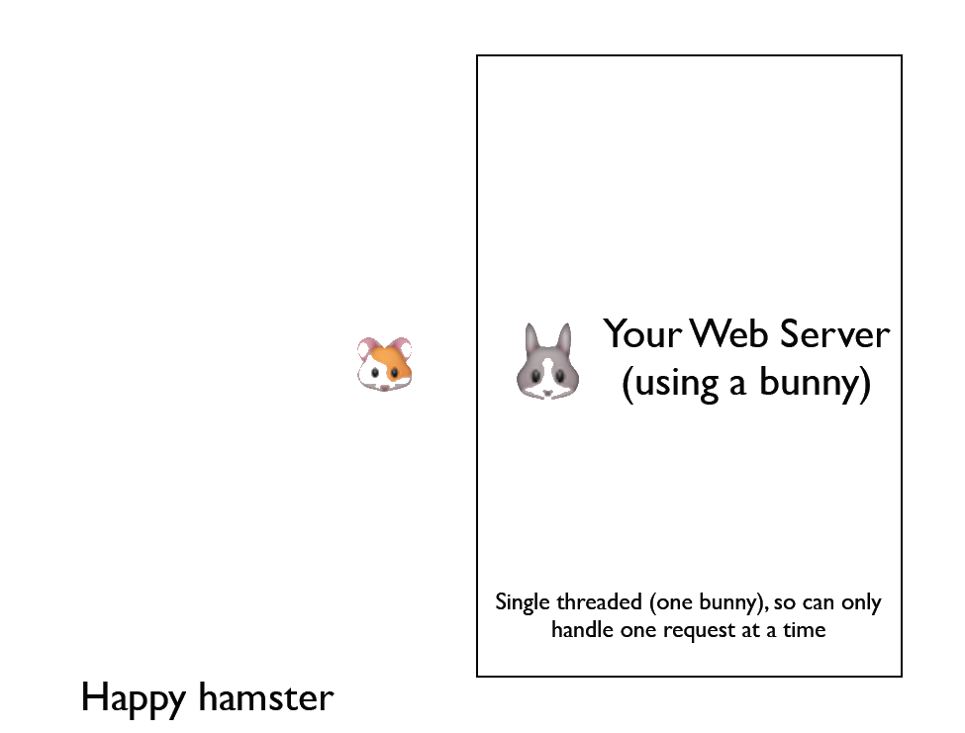

Slide 7
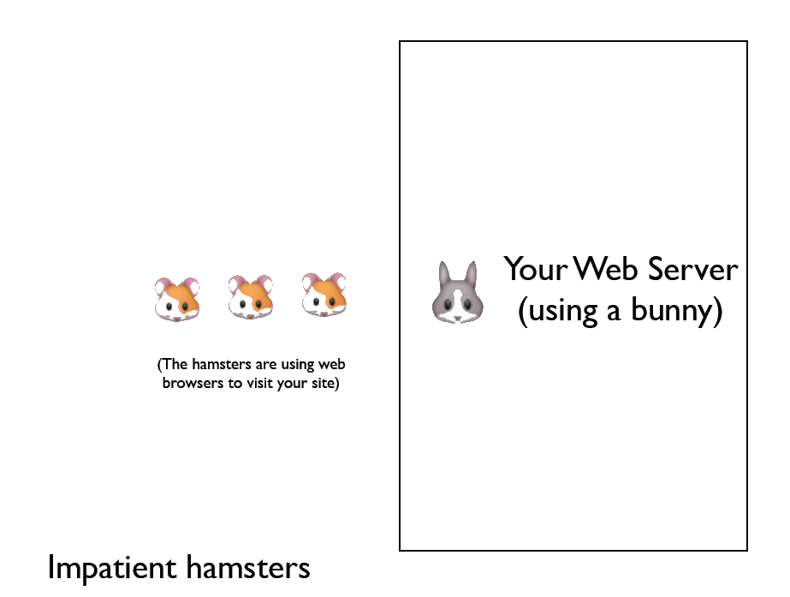

Slide 8
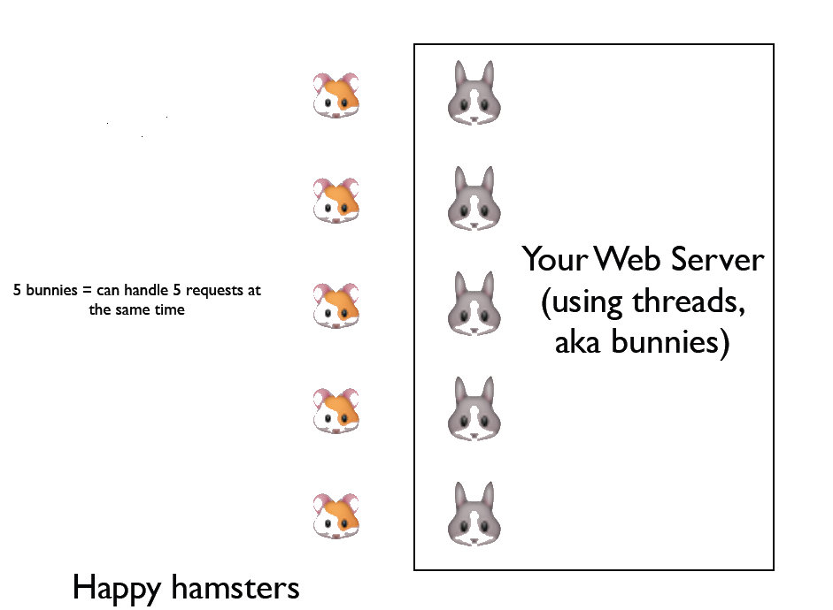

Slide 9
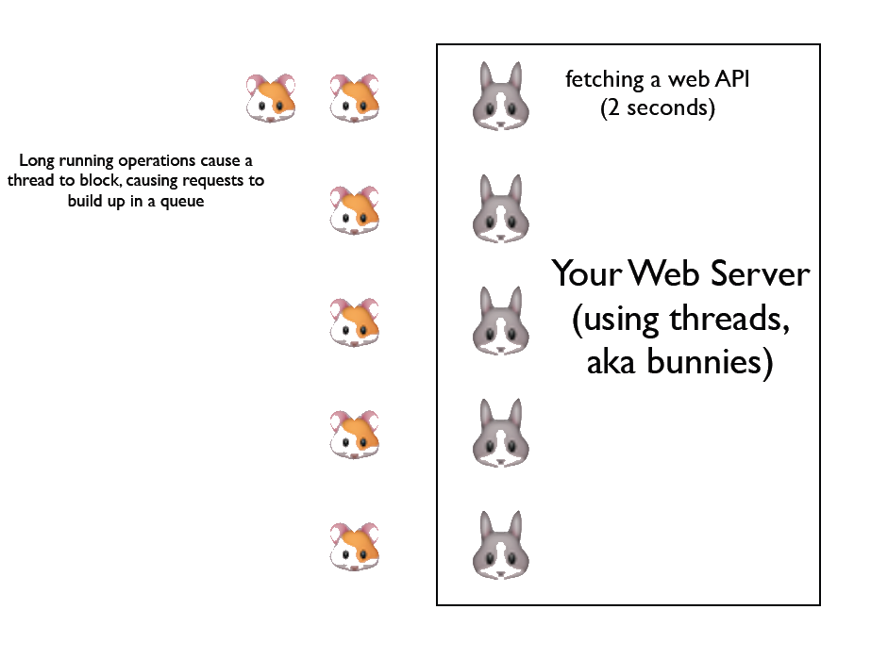

Slide 10
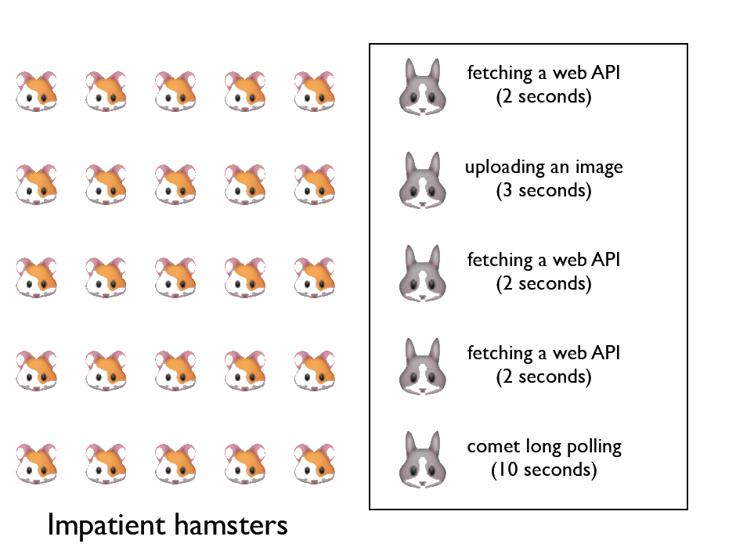

Slide 11
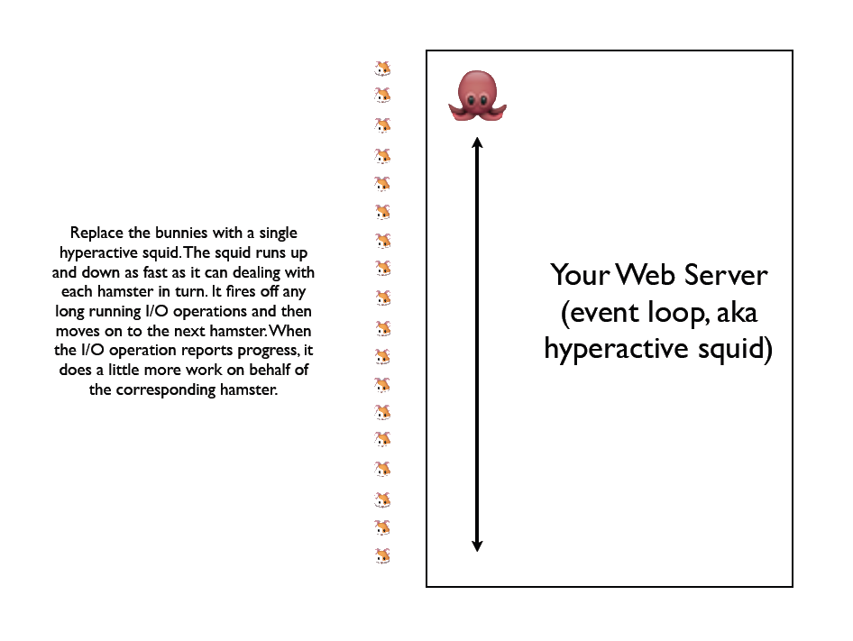

Slide 12


Don’t Block!
Since the Event Loop runs on a single thread you must avoid blocking calls at all times
Bad code snippet….
Good code snippet….

Slide 13
Why JavaScript?
Include fact that functions are first class objects !
http://nodetuts.com/pdf/handson-nodejs-sample.pdf

Slide 14
NPM node package manger
JavaScript closures run on different threads from event loop
Mention joyet and Ryan ?
Only uses 1 core .. Need to run Cluster ?? To get multi core and then there is no inter process comms
Like no sql ovement for web servers…

Slide 15
Hello World!
Build a http webserver in 5 lines of code !!!

Slide 16
Thanks for listening!
email aidancasey@gmail.com
LinkedIn http://www.linkedin.com/pub/aidan-casey/2/a71/353

Slide 17
Debugging
Quick demo of node inspector & point out it doesn’t work in IE !!!
Can you debug in cloud 9…

Slide 18
Demo building simple chat client and deploying to azure

Slide 19
Tools
IISNODE
DEBUGGING
POWERSHELL..
Cloud9ide – built purely on node
Node more active followers than jquery…

Slide 20
References
Evented I/O explained ( courtesy of Simon Willison)
http://www.slideshare.net/simon/evented-io-based-web-servers-explained-using-bunnies

